Slide 1
Agricultural Development in China and
China-Belgium Collaboration
Prof. Wu Kongming
Vice President, Chinese Academy of Agricultural Sciences
Academician, Chinese Academy of Engineering

Slide 2

Contents
Agricultural Development in China:
Current Status and Challenges
2. Agricultural S& T Innovation in China
3. Suggestions on China-Belgium Agri. S&T Collaboration

Slide 3
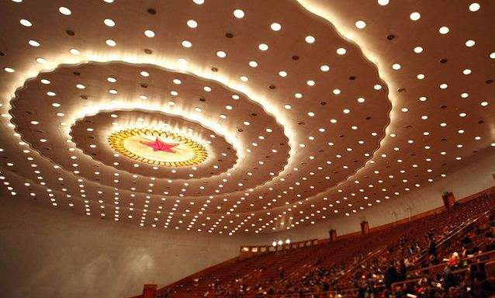
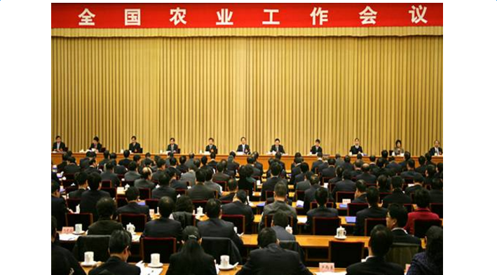
1. Agricultural Development in China:
Current Status and Challenges
2016 is the start year of 13th Five Year Plan in China, the agricultural supply-side structural reform is a top priority.
The central government emphasizes:
To boost the supply-side reform and modernization in agriculture sector
To refine the agricultural structure and develop diverse kinds of appropriate business models
To promote the positively interacting between urbanization and agricultural modernization
We aim to improve agricultural efficiency, increase rural incomes sustainably, and enhance sustainable development.

Slide 4
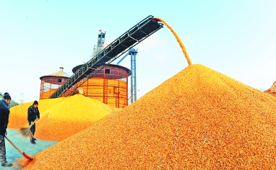
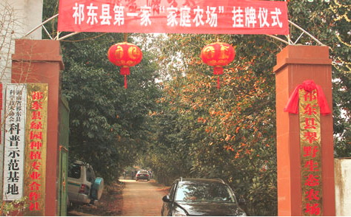
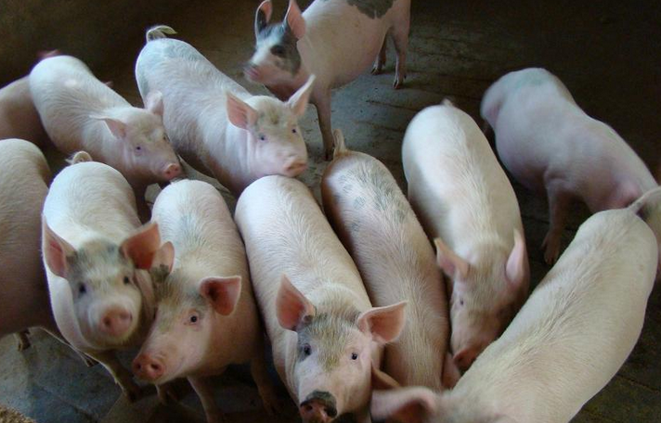
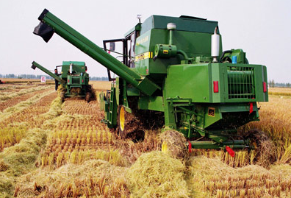
1.1 Agricultural Development in China
An new increase obtained in overall agricultural production capacity
New progress achieved in agricultural operating system
Continuous increase gained in contribution rate of agricultural scientific and technological progress
A new growth given in farmer’s income level

Slide 5
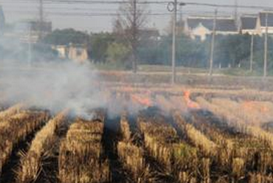
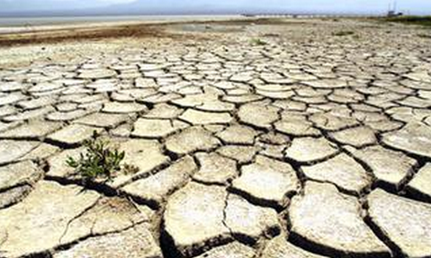
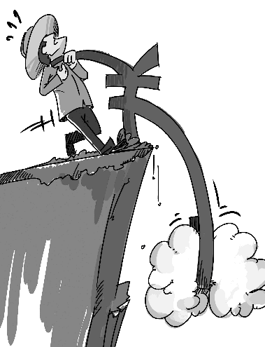
1.2 Challenges of agricultural development
The agricultural modernization development is still in backward status, facing 3 challenges
Prominent issue 1: the restriction of agricultural resources and environment becomes more and more severe.
The decrease in the cultivated land area and quality, the overexploitation of groundwater, and worsening of agricultural non-point source pollution. The restriction of agricultural resource factors become more and more strong, and the condition of agricultural ecological environment is rather serious.
Prominent issue 2: the imbalance in the structure of agricultural production has already become a growing problem
The distribution of agricultural regions is not matched with the resource endowment .The grain-feed structure is not reasonable, and the increase in the stocks of some agricultural products coexists with the increase in their imports. Incompact combination between the crop and the animal production, poor circulation and reduced soil fertility coexist with the incomplete utilization of breeding industry wastes.
Prominent issue 3：the low quality and efficiency of agricultural development becomes a growing problem.
The agricultural production costs show a rising trend, and the international prices of primary agricultural products are already lower than their domestic prices. Under the pressure from the “floor cost” and the “ceiling price”, the agricultural comparative benefits continue to decline.

Slide 6
1.3 New Requirements to S&T Development
Changing growth pattern and regulating structure to realize sustainable development
Under the basic principle of one control (controlling agricultural water) , two reductions (reducing the amounts of chemical fertilizers and pesticides) and three basic utilizations (basic resource utilization of plastic film, crop straw and animal manure), realizing the transformation from resource overuse to saving and high-efficient use.
Establishing the modern agricultural industry system with a high degree of integration among the primary, the secondary and the tertiary industry
Establishing the modern agricultural industry system with a high degree of integration among the primary, the secondary and the tertiary industry.
Expansion and change of agricultural multi-functions
Utilizing the functions of nutritional materials and functional factors of organism fully to meet the new needs of human beings

Slide 7
2. Agricultural S& T Innovation in China
National Agriculture Research System
NATIONAL
PRIVATE
PREFECTURE
MOA
CAS
PROVINCIAL
CAAS
CATAS
CAFS
MOE
Agro Research Institute
…
Agri University
...
Regional Research Organizations: 1115
Extension Entities: 126,000
Agri. Universities: 42
Agricultural training bodies: 100+
Researchers : 270,000
Extension personnel: 777,000

Slide 8
Overview
Establishment
1957
CAAS
A comprehensive agricultural scientific research institution directly affiliated to the Ministry of Agriculture (MOA)
Category
10 functional departments, 34 directly affiliated institutes, 10 institutes jointly established with local governments, the Graduate School and the Agricultural Science and Technology Publisher
CAAS affiliated entities
7,600 professional and technical personnel, accounting for 80.9% of staff; over 4,000 graduate students; over 5,900 retired personnel
Employee
Conduct national major basic research, applied basic research, applied research and high-tech technology research in agriculture;
Address basic, indicative, comprehensive, key and major issues of S&T in agriculture and rural economic development in China
Objectives & tasks

Slide 9
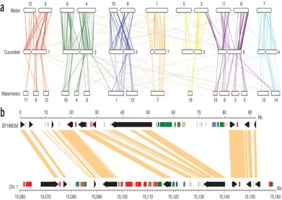
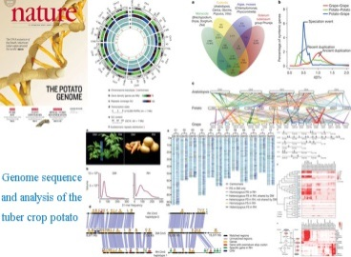
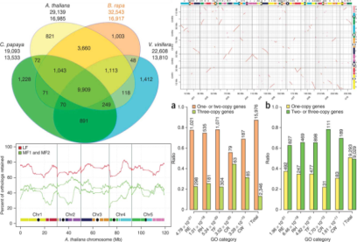
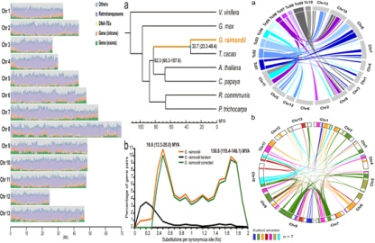
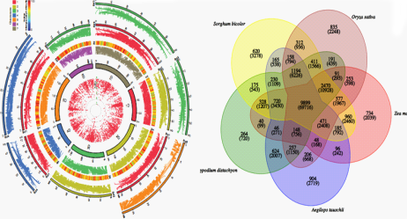
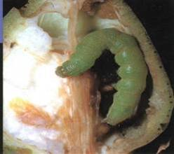
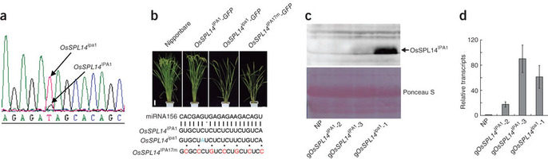



Basic Research in Agriculture
In basic research, CAAS scientists successfully unveiled the infection and transmission mechanism of such major animal diseases as Avian Influenza, led the research and accomplishment of Whole Genome Sequencing and Construction of Genetic Map for 6 important crops such as cotton, cucumber and rapeseed, explained the such mysteries as relationship of yield and resistance to diseases of rice, formation of wheat polyploidization, phenotypic traits of swine mussel accumulation, and environmental and ecological impacts of transgenic cotton.
Cucumber
Potato
Brassica Rapa
Cotton
Wheat
Source: Nature Genetics 41, 1275 - 1281 (2009); 43, 1035–1039 (2011); etc.
Regulation of Osspl14 By Osmir156 Defines Ideal Plant Architecture In Rice
Cotton Bollworm Monitoring and
Forecasting System
Source: Nature 42, 541–544 (2010)

Slide 10
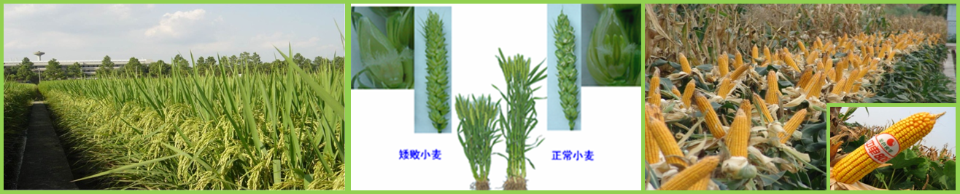
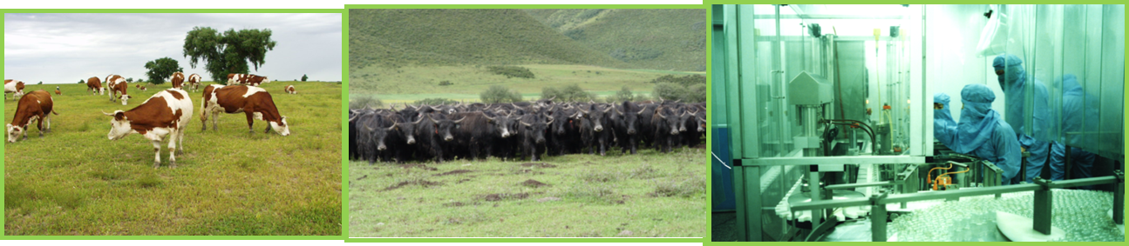
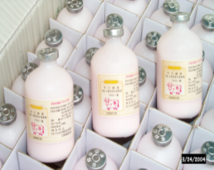
Applied Research in Agriculture
In applied research, CAAS scientists achieved a series of successes in key technology breakthrough, new varieties and new products, which have greatly support the entire agricultural development in China.
Super Rice 14.1 ton/ha (2011)
Dwarf Male-Sterile Wheat
Zhong Dan Corn
Chinese Simmental
Datong Yak breeding
Animal Vaccines

Slide 11
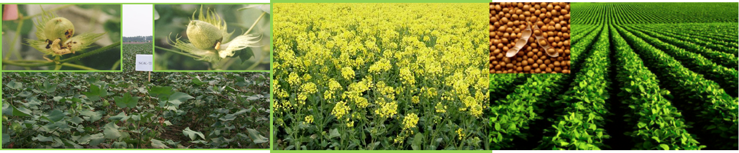
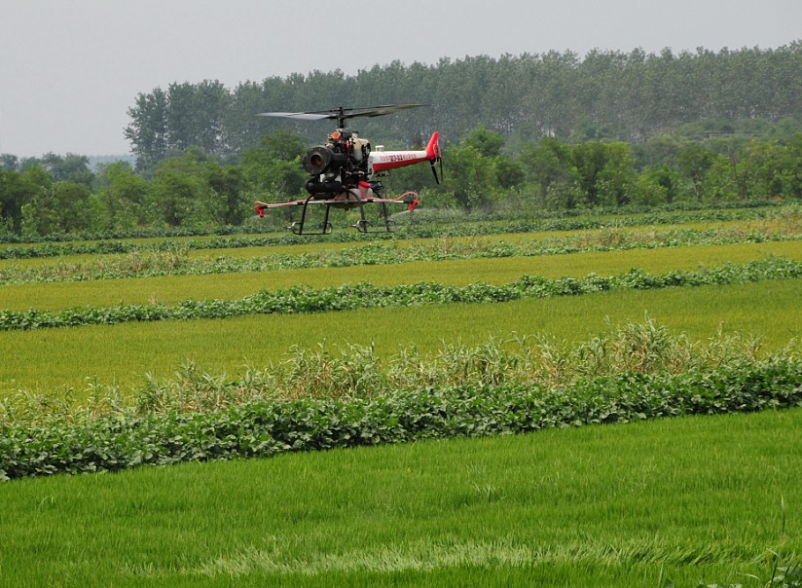
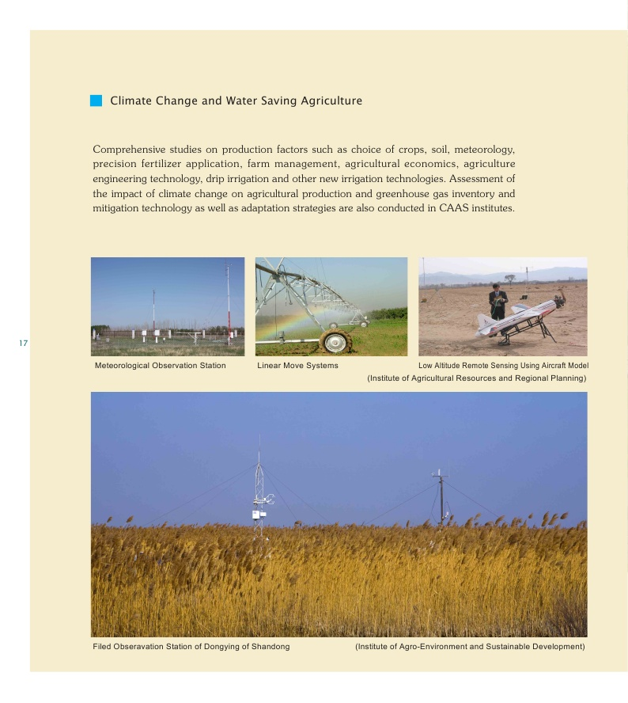
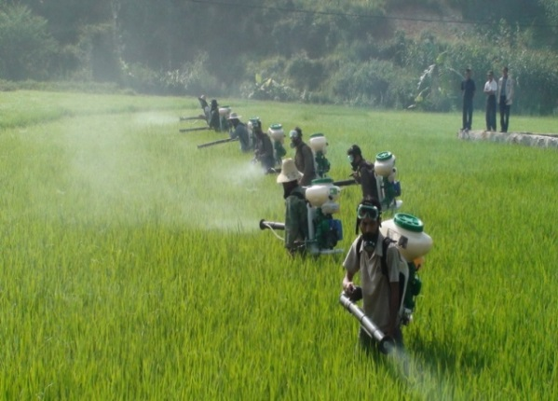
Extension of Agricultural Technology
According to the regional features and requirements, CAAS has successfully carried out high quality and high yield technology integration and high efficiency production mode research plans and actions for 9 major products, i.e. corn, rice, maize, soybean, rapeseed, dairies etc. in cooperation with 210 organizations across the country.

Slide 12
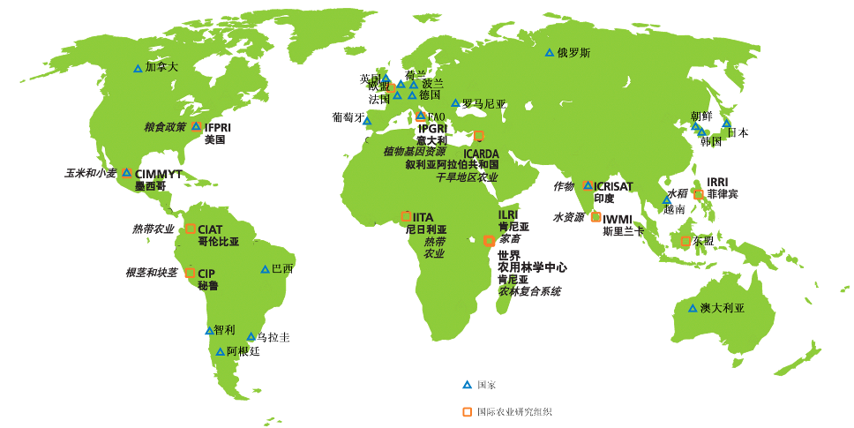

International Cooperation of CAAS
CAAS
CAAS:
- 83 countries
- 36 international organizations
- 6 multinational corporations
- 13 representative offices
- 62 joint-labs

Slide 13
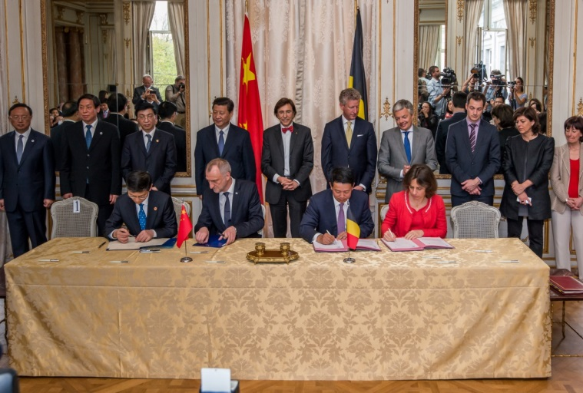
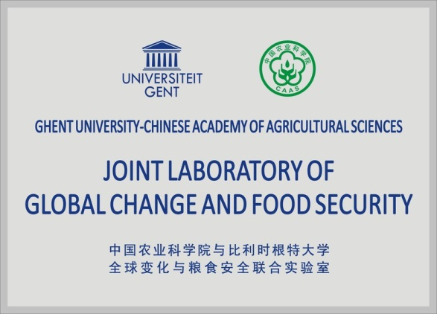
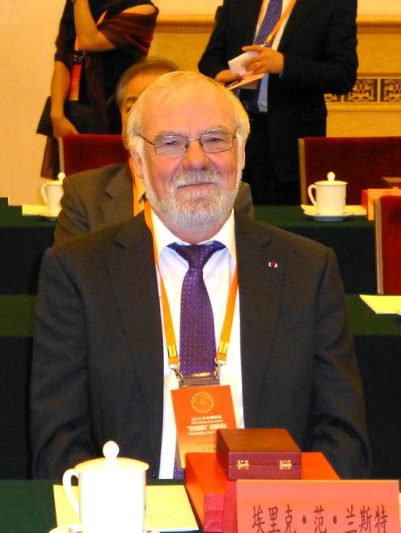
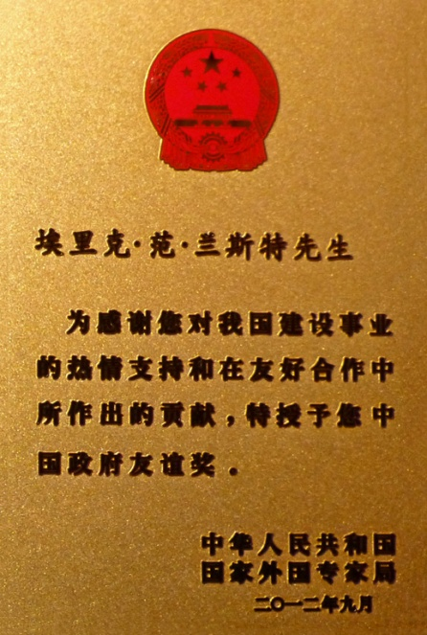
3. Suggestions on China-Belgium
Agricultural Science and Technology Collaboration
Productive Collaborative History
The Agreement for the Establishment of the Joint Laboratory of Global Change and Food Security between Chinese Academy of Agricultural Sciences and Ghent University was signed on 31 March 2014 in Egmont Palace, Brussels in the presence of the President of China, Mr. Xi Jinping and the Prime Minister of Belgium, H. E. Mr. Elio Di Rupo.
Prof. Dr. Eric Van Ranst received the Friendship Award of the Government of China in 2012

Slide 14
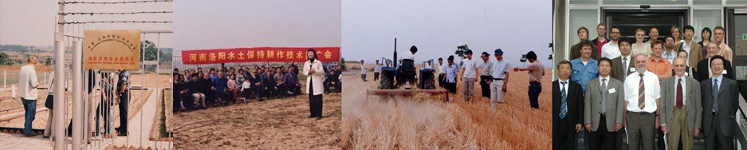
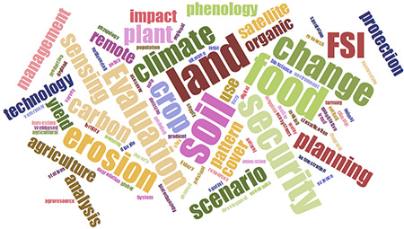
Productive Collaborative History
30+ years of collaboration in soil erosion, land use planning, agro-resource management, bio-technology, remote sensing, plant protection, animal science and veterinary, climate change and food security:
  10+ Joint research projects on soil fertility, soil organic carbon, food security early warning, etc.;
  70+ Joint journal papers on Geoderma, Nutrient Cycling in Agroecosystems, Global Environmental Change, etc.;
  30+ academic exchange
  10+ Joint book titles e.g. China’s Agenda 21;
  2 national, 5 provincial awards.
Sponsorship: Unilateral-to-bilateral transition…

Slide 15
Proposals for Future Collaboration
Enhance scientists visits and joint PhD training
Encourage cooperative research on prioritized topics such as soil erosion assessment, land usage, natural recourses management, agricultural biotechnology, agricultural remote sensing and plant protection, and jointly apply for calls from China, Belgium and EU
Under the framework of the Ghent University-CAAS Joint Laboratory of Global Change and Food Security, jointly explore new ways of comprehensive collaboration

Slide 16
Thank You !

